Slide 1
Reinforcement Learning
Session 1
The Basics
.
( Disclaimer: content has been taken from various authors and websites)
Notes:
2/16/2019
1

Slide 2
Todays Agenda
Reinforcement Learning
Situational Awareness for an Autonomous Vehicle. (Think Tank Session)
Questions.

Slide 3
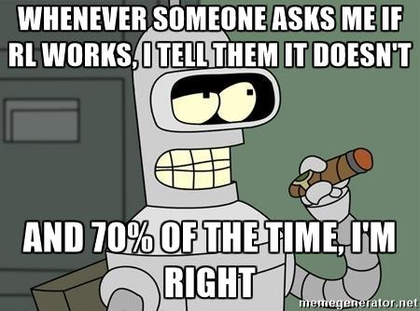

Slide 4
Learning ?
Learning takes place, as a result of an interaction between the Person (Agent) and the World (Environment).
Some things we can all do ( walking)
Some things we can learn to do (cycling)

Slide 5

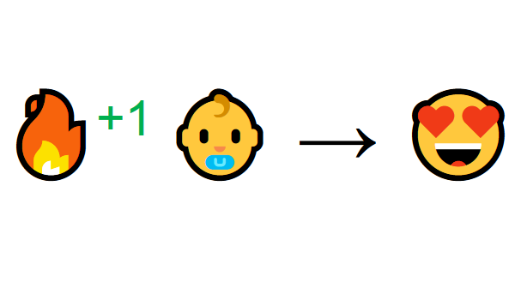
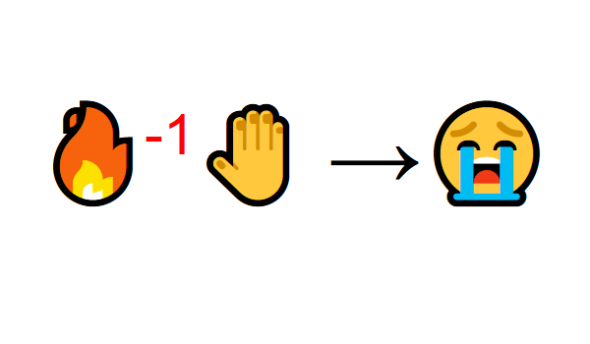

Slide 6
What is RL ?
Reinforcement learning is learning what to do—how to map situations to actions—so as to maximize a numerical reward signal.
The learner is not told which actions to take, but instead must discover which actions yield the most reward by trying them.
In some cases, actions may affect not only the immediate reward but also, subsequent rewards.
Two most important features of reinforcement learning
trial-and-error search
delayed reward

Slide 7
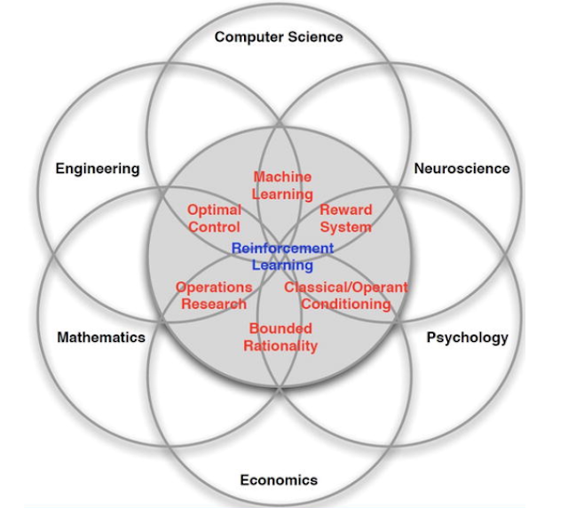

Slide 8
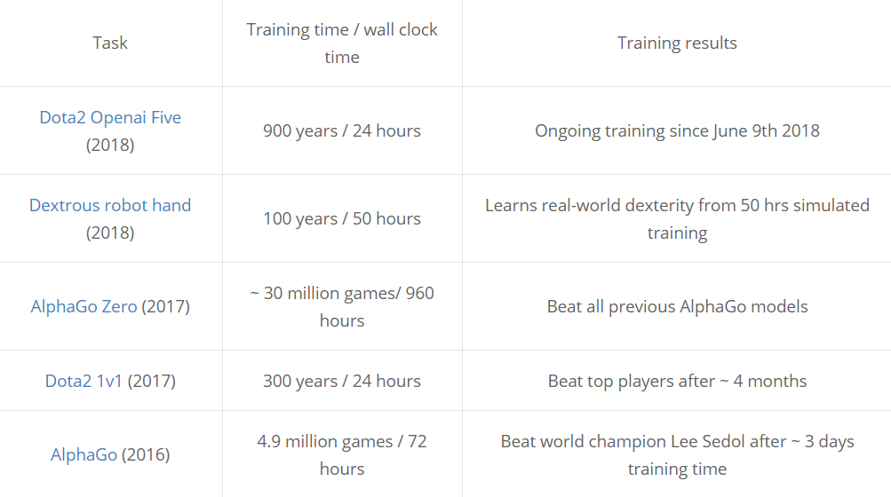
S

Slide 9

Components of RL ?
Environment: Physical world in which the agent operates
State: Current situation of the agent
Reward: Feedback from the environment. It’s a real NUMBER
Policy: Method to map agent’s state to actions
Value: Future reward that an agent would receive by taking an action in a particular state

Slide 10
Main Components of RL
Learning to map States to actions so as to maximize a numerical reward over time.
MultiStage decision.
Agent must learn by Trial and Error.
Actions may affect not only immediate reward, but also subsequent rewards (Delayed Effect).

Slide 11
Exploration v/s Exploitation
Maximizing not just immediate reward , but cumulative reward in the long run.
Exploitation : Make the best decision given current information.
Exploration: Gather more information.
The best long–term strategy may involve short–term sacrifices .
Gather enough information to make the best overall decisions.
This is the question every agent must learn to answer from the start, do I keep following this policy that’s giving me nice returns, or do I take some relatively sub-optimal actions now in case there’s a possibly bigger payoff later?
This problem is so hard because there can be no right answer in general - there is always a trade-off
Eg:
Restaurant Selection
Exploitation: Go to favorite restaurant
Exploration: Try a new restaurant.

Slide 12
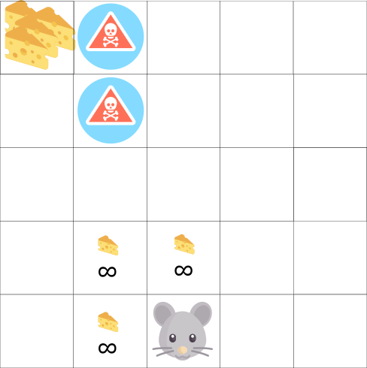
Exploration v/s Exploitation
The mouse can have an infinite amount of small cheese (+1 each).
At the top of the maze there is a gigantic sum of cheese (+1000).
If we only focus on immediate reward, our mouse will never reach the gigantic sum of cheese. It will only exploit the nearest source of rewards, even if this source is small (exploitation).
But if our mouse does a little bit of exploration, it can find the big reward.

Slide 13
Why Explore?
The first question one may ask is: why do we need exploration at all?
Its part of our instinct, intrinsic desire to explore.
Many of the games we play like World of Warcraft, Doom. all reward exploration.
The problem can be framed as one of obtaining representative training data. In order for an agent to learn how to deal optimally with all possible states in an environment, it must be exposed to as many of those states as possible.
Unlike in traditional supervised learning settings however, the agent in a reinforcement learning problem only has access to the environment through its own actions.
As a result, there emerges a chicken and egg problem:
An agent needs the right experiences to learn a good policy, but it also needs a good policy to obtain those experiences.

Slide 14
Greedy Approach
All reinforcement learning algorithms seek to maximize reward over time.
A Simple approach to ensuring the optimal action is taken at any given time is to simply choose the action which the agent expects to provide the greatest reward, at the current moment is an example of exploitation:
The agent is exploiting its current knowledge about the reward structure of the environment to act.
This approach providing little to no exploratory potential.
The problem with a greedy approach is that it almost universally arrives at a suboptimal solution.

Slide 15
Random Approach
The opposite approach to greedy selection is to simply always take a random action.
Shortcomings: Only in circumstances where a random policy is optimal would this approach be ideal. However it can be useful as an initial means of sampling from the state space in order to fill an experience buffer when using DQN.

Slide 16
ϵ-Greedy Approach
A simple combination of the greedy and random approaches yields one of the most used exploration strategies: ϵ-greedy. In this approach the agent chooses what it believes to be the optimal action most of the time, but occasionally acts randomly.
The ϵin ϵ-greedy is an adjustable parameter which determines the probability of taking a random, rather than principled, action.

Slide 17
Challenges
Greater Skillset to master
Complex Algorithms
Less Mature Tools
Accurate Simulations of real world environments

Slide 18
Difference Between Supervised, unSupervised and RL
Normal ML |  | RL
Train On Datasets |  | No Datasets
Interacts with Data |  | Interacts with Environment
Supervised |  | RL
feedback provided to the agent is correct set of actions for performing a task |  | rewards and punishment as signals for positive and negative behavior
Un Supervised |  | RL
goal in unsupervised learning is to find similarities and differences between data points |  | goal is to find a suitable action model that would maximize the total cumulative reward of the agent

Slide 19
RL Applications
Its very useful in situations, where information about the world is limited, there is no map of the world.
It has to learn it’s actions, by interacting with the environment, via trial and error.
Once we take an action we can observe our state/results and change our action next time.
Robotics
Industrial Automation
Game Playing
Autonomous Vehicles
Medicine

Slide 20
Contact Details
Email: aliasgertalib@gmail.com
Linkedin: https://www.linkedin.com/in/aliasgertalib
GitHub
https://github.com/aliasgertalib-AI

Slide 21
References
OpenAI Gym
Donkey Car

